Slide 1


thesis defense for engineering degree
Ecole Centrale Casablanca
25.10.2023
Distillation Learning
RISQ/MRM
Omar Elghaffouli
Imen Fourati
Zineb Baroudi & Nada Amini
Société Générale : 17, Cours Valmy, 92000, Puteaux, France

Slide 2
OUTLINES
INTRODUCTION
Context and Motivation
Knowledge Distillation Basic Definition
Missions
Literature review overview
Methodology
Distillation Learning Fundamentals
Relevant Frameworks
Potential Uses in RISK/MRM
Distillation of pd estimation models on France’s SME PORTFOLIO
Teacher Training
Response-Based Distillation
Adversarial Knowledge Distillation Framework
X-Distillation Framework
References
Appendix
Distillation Tests on Lending Club Dataset
Cross Validation to determine the optimal bandwidth h
Relation-Based Distillation Framework Example
Self-Distillation Framework Example

Slide 3
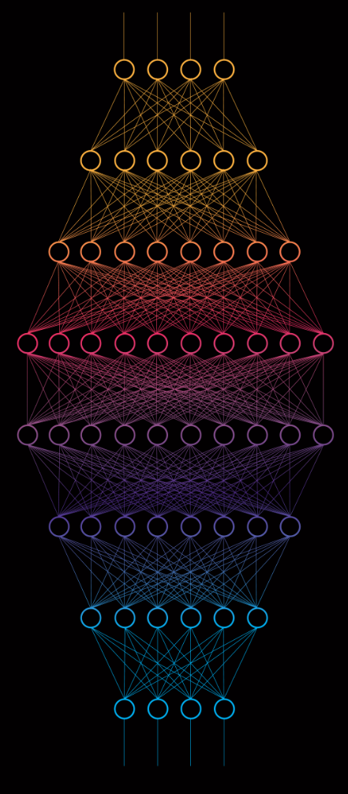
1. INTRODUCTION
A. Context and Motivation
B. Knowledge Distillation Basic Definition
C. Missions

Slide 4
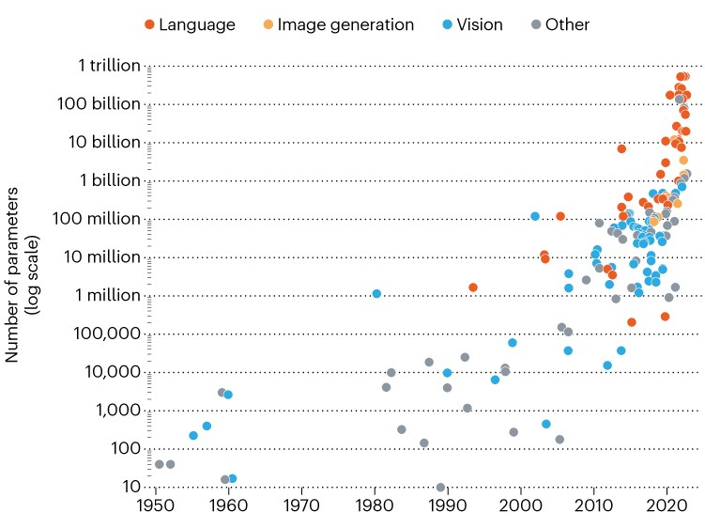
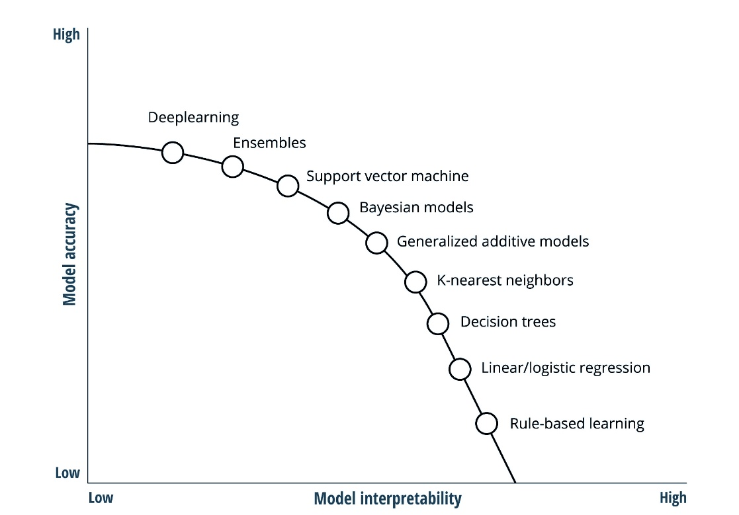
A. Context and motivation (1/2)
Figure 1. The drive to bigger AI models. The scale of AI neural networks models is growing exponentially, as measured by the models’ trainable parameters, source: Nature
Figure 2. Inherent trade-offs between model accuracy, complexity and model interpretability. Source: Deloitte Insights
The final report of European Banking Authority (2020) urges banking institutions to "understand the models used, and their methodology, input data, assumptions, limitations and outputs".

Slide 5
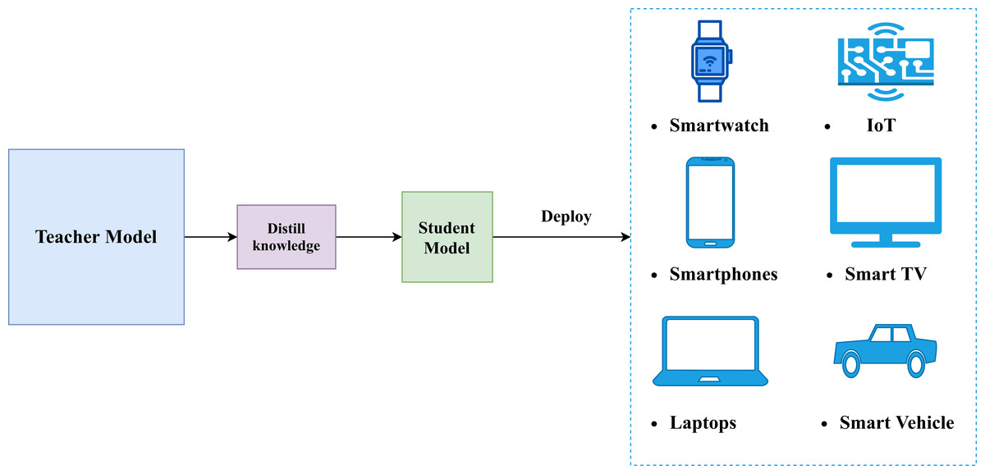
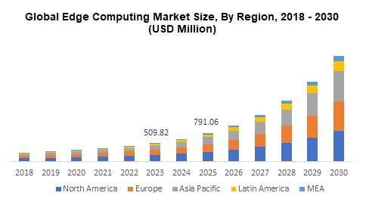
A. Context and Motivation (2/2)
Figure 3. Knowledge Distillation for Edge Computing
Figure 4. Edge Computing Market is gaining in size over years. Development of small and less cumbersome models is then mandatory to fit in edge device computing capacity. Source

Slide 6
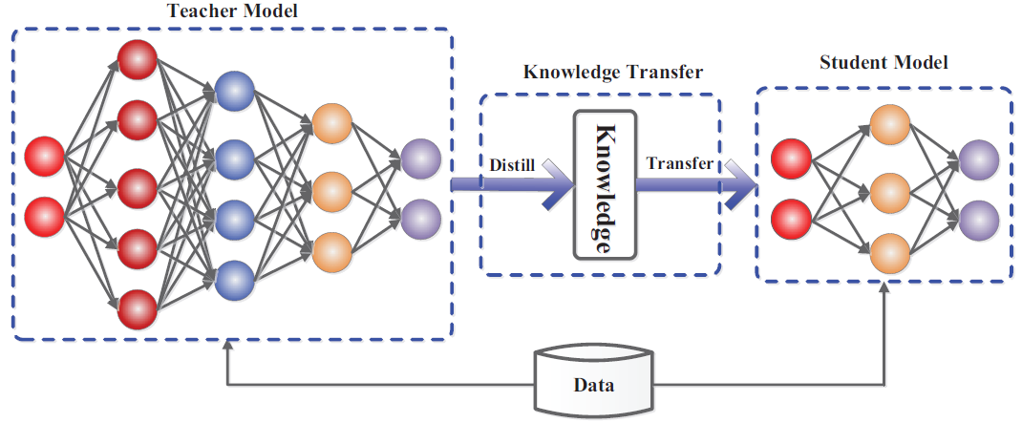
B. Knowledge Distillation Fundamental DEFINITION
Figure 5. The generic teacher-student framework for knowledge distillation. Source: Arxiv
2 Main Questions in the Context of RISK/MRM at Société Générale
What are the main uses of knowledge distillation in the context of model risk management ?
How can distillation learning be used in improving models’ interpretability and performance ?

Slide 7
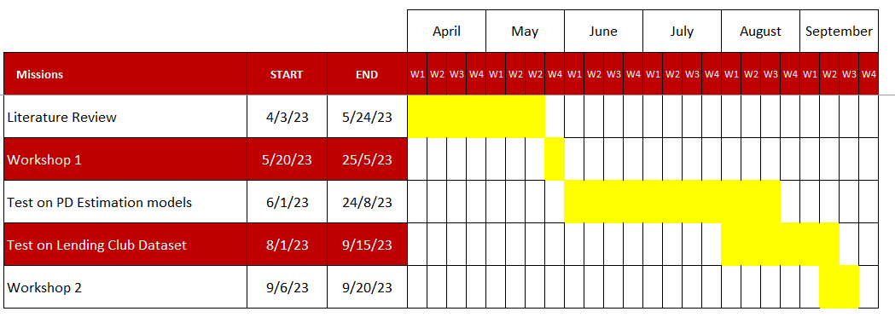
C. Missions
Figure 6. Gant chart of internship’s missions

Slide 8
2. Literature review overview
A. Methodology
B. Distillation learning fundamentals
C. Relevant frameworks
D. Potential Uses in RISK/MRM

Slide 9
A. Methodology
Distillation Learning Fundamentals
Distillation Learning Relevant Frameworks
Distillation Learning Relevant Application
Figure 6. Literature Review Milestones, 29 Scientific paper on knowledge distillation were reviewed.

Slide 10
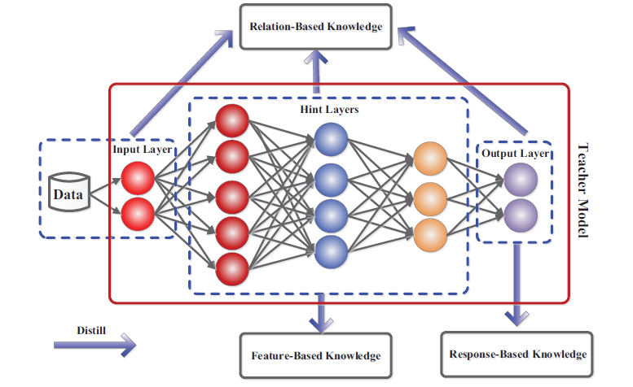
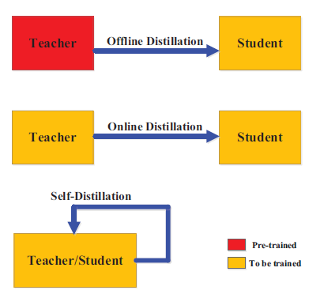
B. Distillation learning fundamentals (1/3)
Figure 7. The schematic illustrations of sources of knowledge in a deep teacher network
Figure 8. Different Distillation Training Modes

Slide 11
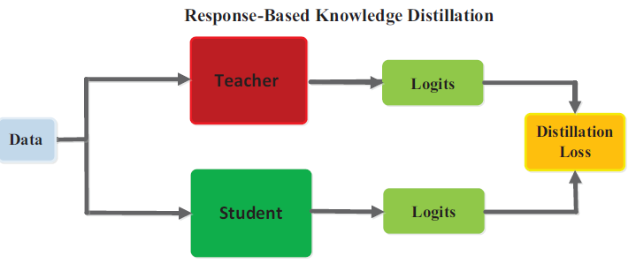


Response-Based Knowledge
A. Distillation learning fundamentals (2/3)
The classical framework for knowledge distillation. The student tries to mimic as good as possible the output predictions of the teacher model in a response-based manner. Practically, we use logits (Neurons outputs before SoftMax) because they contain dark knowledge which is the deep knowledge learnt by the teacher.
Figure 9. The specific architecture of the benchmark knowledge distillation. The student model can learn to mimic teacher’s predictions and ground truth labels.
Pros | Knowledge | Limits
Easy-to-use, straight-forward Fast, efficient | Predictions of the teacher model Dark knowledge embedded in soft targets or in logits (Hinton and al, 2015, Caruana and al, 2014). | Limited to supervised learning Relies on the final output fails to address intermediate-level supervision
Formula 1. Hinton Loss for Response-Based KD, Source, Hinton and al, 2015
Table 1. Response-based distillation investigation
Formula 2. Hinton Soft-Targets for Response-Based KD, Source, Hinton and al, 2015; very high T values correspond approximately to matching logits.

Slide 12
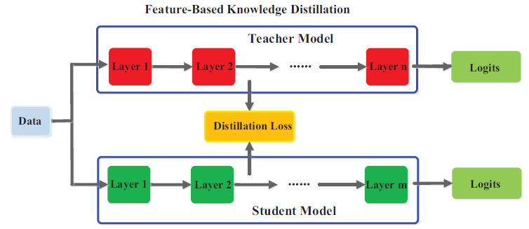
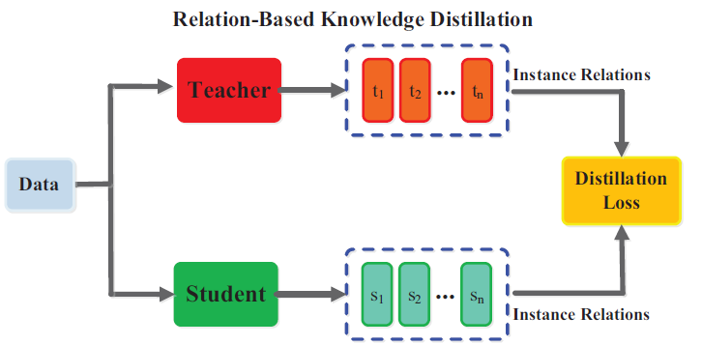
Other types of Knowledge distillation
A. Distillation learning fundamentals (3/3)
Figure 10. The generic feature-based knowledge distillation.
Figure 11. The generic relation-based knowledge distillation.
Pros | Knowledge | Limits
Learn multiple levels of feature representation. | 1) Feature representation, hint layers (Romero et al., 2015) 2)Parameter distribution, multi-layer group (Liu et al., 2019c) 3)Feature Maps, hint layers (Chen et al., 2021) | Effectively choose the hint layers from the teacher model and the guided layers from the student model with optimum training complexity is questionable.
Pros | Knowledge | Limits
Explores the relationship between layers or data samples. | 1) FSP matrix, End of multi-layer group (Yim et al., 2017) 2) Logits graph, hint layers (Zhang and Peng, 2018) 3) Similarity Matrix, hint layers (Tung and Mori, 2019) | Relation modeling difficulties
Table 2. Feature-based distillation investigation
Table 3. Relation-based distillation investigation
.

Slide 13
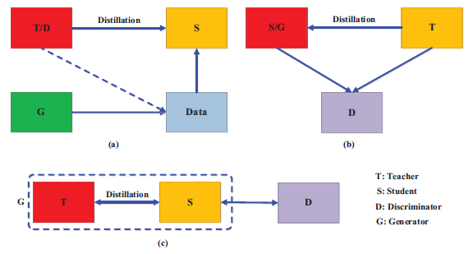
Adversarial Knowledge Distillation
B. Relevant frameworks (1/3)
An effective framework to enhance the power of student learning via the teacher knowledge distillation using GAN. This framework tackles two main problems;1) Difficulty for the teacher to learn the true data distribution (lack of data, unrepresentative data, small model, etc.); 2) Small capacity of the student and difficulties to mimic accurately the teacher ( Capacity gap, Unreliable teachers)
Scheme | Explanation
(a) | A generator is trained on true data distribution. Generated Data go then through teacher discrimination based on its proper data distribution. Student learns then teacher knowledge from 2 sources; 1) classical distillation process, 2) through generated data embedding teacher’s internal feature representation.
(b) | A discriminator is trained on teacher’s feature distribution. In addition to traditional distillation process, the student will generate new data based on its internal feature distribution corrected each time by the discriminator. The generated data is not used for training.
(c) | A discriminator is trained on true data distribution and corrects feature distribution of generators which are the student and teacher in an online setting.
Figure 12. The different categories of the main adversarial distillation methods.
Table 4. Adversarial Knowledge Distillation Framework’s detailed explanation.

Slide 14
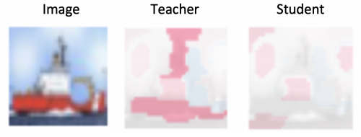
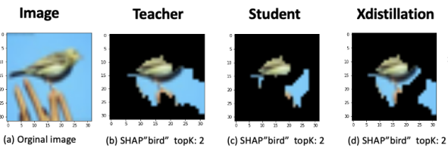
Interpretability distillation
B. Relevant frameworks (2/3)
Teacher explanation are important features driving a specific prediction. However, traditional distillation doesn’t distill explanation and thus, student predictions are not driven by the same features due to explanation inconsistency between the teacher and the student.
Alharbi and al., 2021 have proposed a novel framework to distill explanation in addition to dark knowledge called XDistillation (XD). The framework has outperformed all traditional distillation methods.
BEFORE
AFTER
XD
Figure 12. Inconsistency between teacher and student explanation
Figure 13. The overlapping explanation area of teacher, KD and XD.
Model | Accuracy % | #Parameters
Teacher | 93.78 | 14,728,266
Baseline Student | 89.2 | 2,781,386
Response-Based Distillation | 90.2 | 2,781,386
X-Distillation | 90.9 | 3,521,276
Table 5. X-Distillation performance Comparing with response-based distillation

Slide 15
Main Use of Knowledge Distillation in RISK/MRM
3 Main Potential Uses of Knowledge Distillation in RISK/MRM
1
2
3
XAI
If we have an inexplicable teacher such as a deep neural network or a random forest, we can use distillation of the teacher to train an interpretable and transparent model such as a decision tree along with being close to the teacher performance.
Enhancing Performance
A simple model is such as logistic regression, random forest, decision tree, linear regression or a simple neural network.
Reducing Models Complexity
In the context of compression, distillation can be used to reduce models' complexity.
In this case, the trade off performance/interpretability must be balanced depending on the situation.
In MRM context , performance of PD Estimation Models can be enhanced by training a complex model such as deep neural network and then distilling it into a student model.
Training a simple model through distillation of a more complex model usually outperforms training directly the same simple model.
Usually, we use the teacher for inference alongside with student’s interpretability insights.
We can also enhance performance of more sophisticated models by using self-distillation and transfer learning frameworks
However, the student cannot outperform the teacher in general due capacity gap.
In result, several frameworks were developed by scholars to reduce the performance gap between the teacher and the student.
Some of the most relevant frameworks are adversarial knowledge distillation, interpretability distillation and transfer learning.

Slide 16
2. Distillation OF PD ESTIMATION MODELS
Teacher Training
Response-Based Distillation
Adversarial Knowledge Distillation Framework
X-Distillation Framework

Slide 17
INTRODUCTION TO PD ESTIMATION MODELS FRAMEWORK
PD ESTIMATION MODELS ARCHITECTURE FOR FRANCE’S SME PORTFOLIO
Stacking
Train
Logistic Regression 1
Module Data 1
Train
Output 1
Module Data 2
Logistic Regression 2
Output 2
Training
All modules Logistic Regression
Final output
PD Prediction
Train
Logistic Regression 3
Output 3
Module Data 3
Train
Output 4
Module Data 4
Logistic Regression 4
Figure 15. PD Estimation Models Training Workflow
Modules | Training AR* | WT Test AR | OOT Test AR
Module 1 | 55,3% | 53,2% | 60,2%
Module 2 | 53,91% | 52,98% | 57,43%
Module 3 | 64,7% | 64,4% | 66,76%
Module 4 | 28,86% | 28,88% | 32,78%
All Modules | 65,4% | 66,2% | 66,4%
2 TYPES OF TEST DATA ARE USED:
Within Time TEST SET : Each obligor (borrower) has data records in different date times (panel data)
OUT-OF-TIME SET (OOT): each obligor has one data record at a date fixed in 2018.
Table 7. Performance of PD Estimation Models
Our goal is to enhance the performance of the overall model on the test and out-of-time sets.
*Accuracy Ratio = 2 * ROC AUC – 1

Slide 18
PD estimation models’ Distillation Framework
The objective of the distillation framework is to enhance the overall PD estimation models performance.
Module Data 1
Train
Teacher
Module Data 2
Response-Based Distillation
Adversarial Knowledge Distillation
X-Distillation
Concatenate Modules’ Features
All Features Dataset
One-Hot Encoding
Module Data 3
Student
Module Data 4
Figure 16. PD Estimation Models Distillation Framework

Slide 19
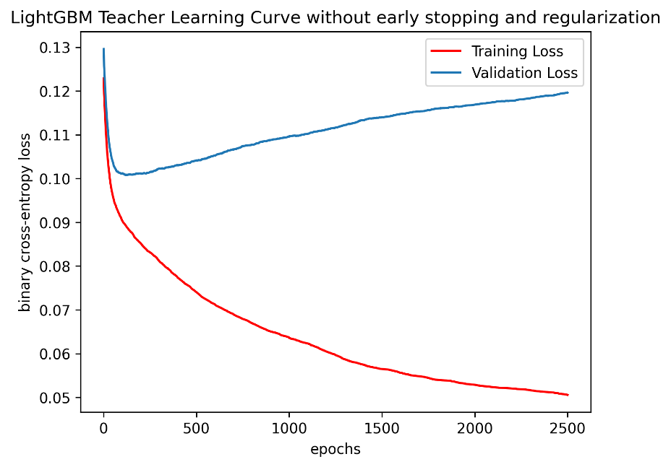
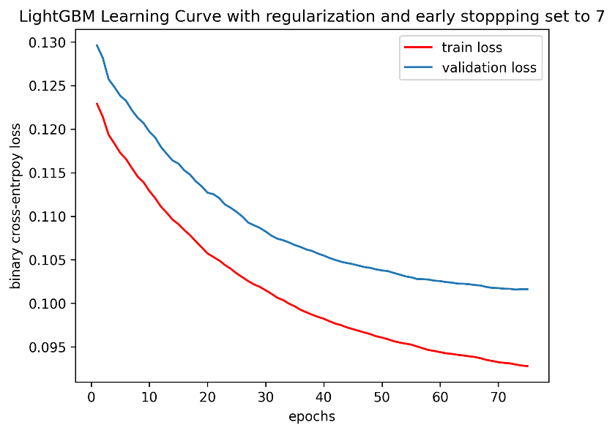
TEACHER TRAINING
Figure 17. LightGBM teacher learning curves without regularization
Figure 18. LightGBM teacher learning curves with regularization (L1 = 0.01 and Early Stopping = 7)
Models | Role | Training AR (%) | WT Test AR (%) | OOT Test AR (%)
PD estimation models | Baseline | 65,40 | 66,20 | 66,4
Feed-Forward Neural Networks (FFNN) | Teacher | 72.28 | 63.25 | 71.28
LightGBM with regularization | Teacher | 70.87 | 67.41 | 71.44
LightGBM without regularization | Teacher | 89.16 | 58.55 | 58.84
Selected Teacher
Table 8. Performance of trained teachers using the framework in Figure 16

Slide 20
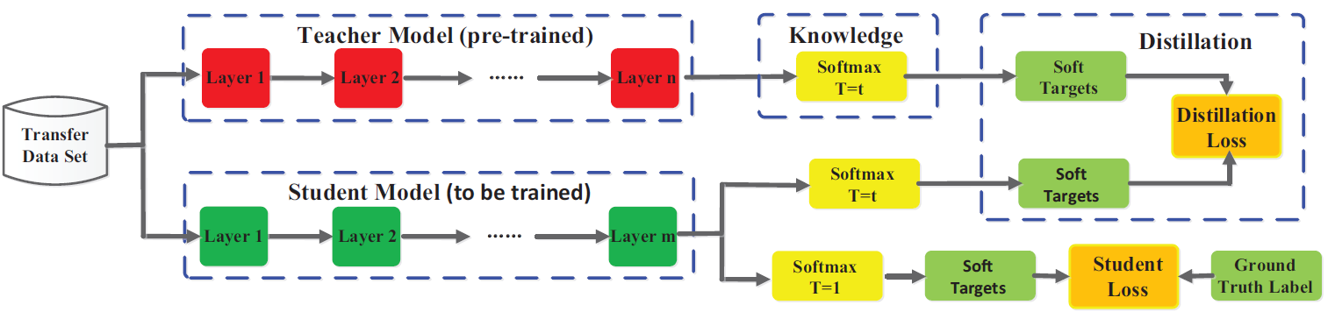

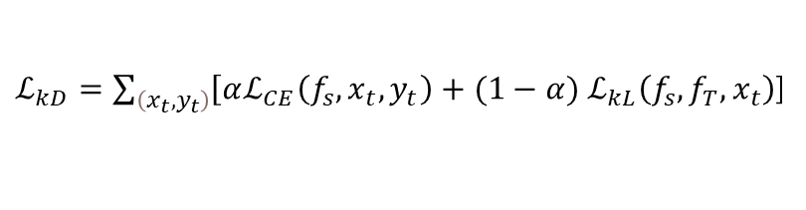
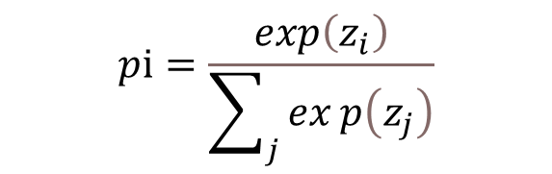
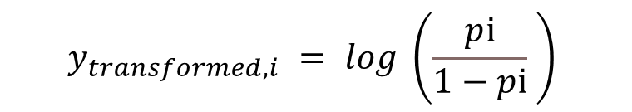
Response-BASED DISTILLATION (1/3)
Response-Based Online Distillation
For comparison matters with PD Estimation Models, we train a logistic regression using response-Based distillation. Practically, we train a linear regression on teacher soft prediction. However, to constraint values to lie between 0 and 1, we apply the following transformation on teacher soft predictions before training:
$$y_{transformed, i} = log \left(\frac{pⅈ}{1−pⅈ} \right)$$
$$pⅈ=\frac{\exp\left(z_{i}\right)}{\sum_{j}{exp\left(z_{j}\right)}}$$
Where $pi$is teacher’s soft prediction for the class i, $z_{i}$ are teacher’s logits and $y_{transformed, i}$ is the new target ranging on the negative real numbers line.
$ℒ_{kD}=\sum_{\left(x_{t},y_{t}\right)}{\left[αℒ_{CE}\left(f_{s},x_{t},y_{t}\right)\right.}+(1−α{) ℒ}_{kL}\left(f_{s}, f_{T},x_{t}\right)$]
Formula 1. Response-Based Knowledge Distillation Loss, $α$ is the contribution of the loss comparing to ground truth labels.
Figure 19. Response-Based Distillation Framework

Slide 21
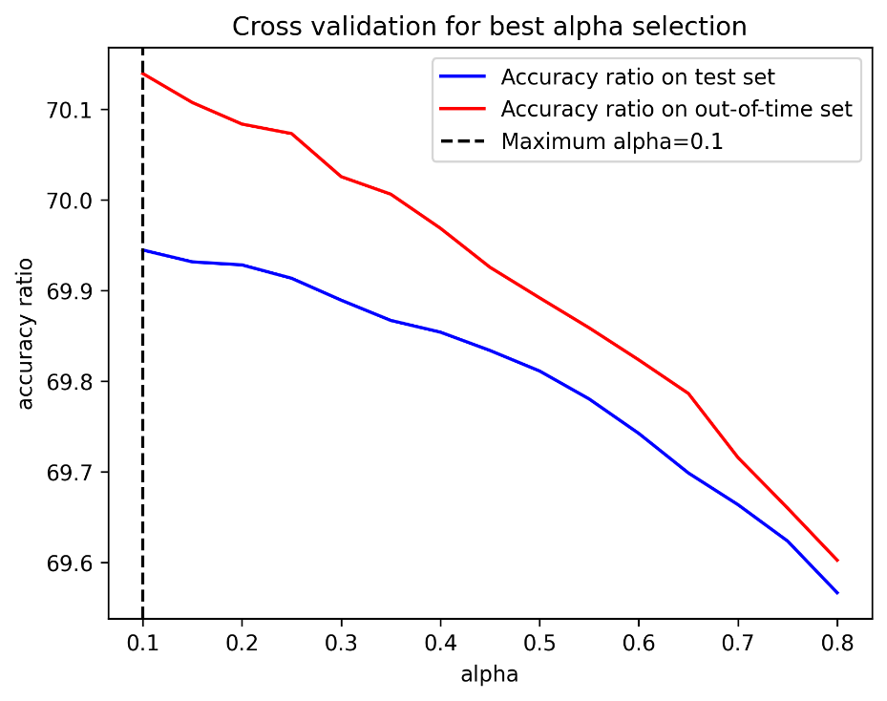
Response-BASED DISTILLATION (2/3)
Response-Based Online Distillation
Figure 20. Cross-validation for best $α$ selection
Models | Role | Training AR (%) | WT Test AR (%) | OOT Test AR (%)
PD estimation models | Baseline | 65,40 | 66,20 | 66,40
LightGBM with regularization | Teacher | 70.87 | 67.41 | 71.44
PD estimation models Distilled without Temperature | Student | 68.03 | 63.94 | 70.13
Remarkable Improvement on out-of-time set
Table 9. Response-Based Students’ Performance

Slide 22
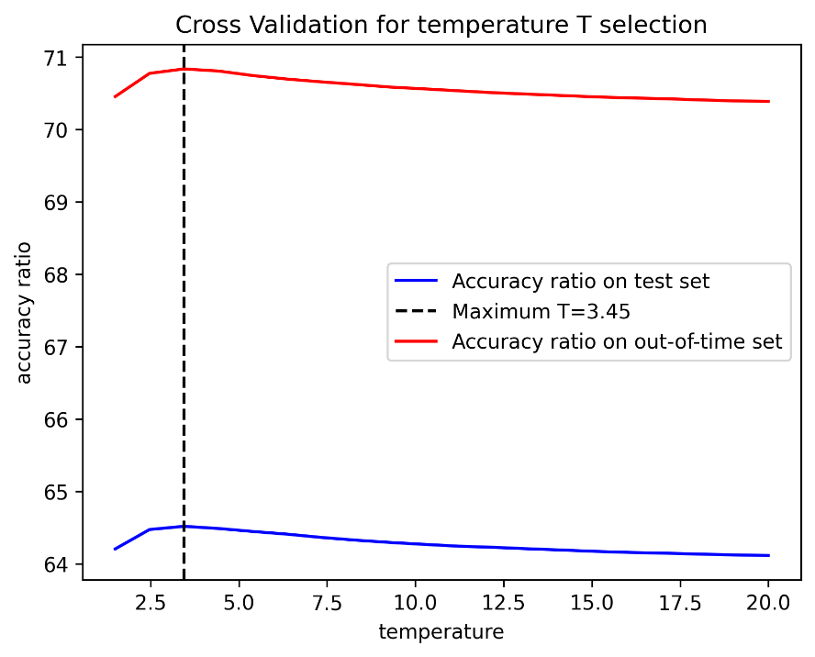
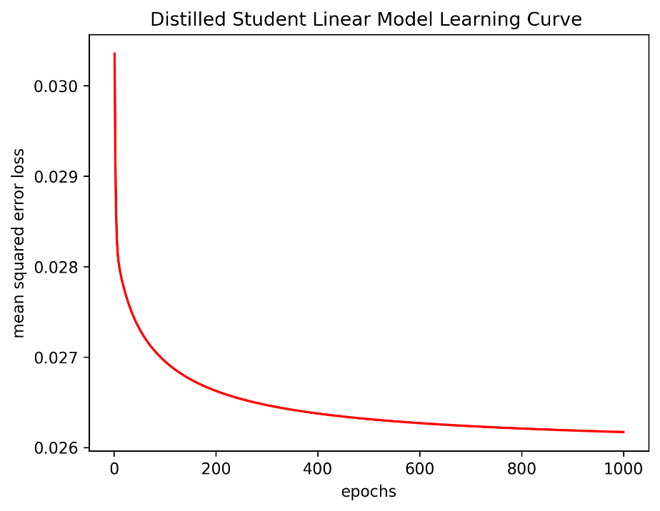

Response-BASED DISTILLATION (3/3)
Response-Based Distillation with Temperature T
Figure 21. Cross-validation for best $T$ selection, T = 3.45 corresponds to the best accuracy ratio on the test set.
Figure 22. learning curve’s training convergence with T = 3.45
Models | Role | Training AR (%) | WT Test AR (%) | OOT Test AR (%)
PD estimation models | Baseline | 65,40 | 66,20 | 66,40
LightGBM with regularization | Teacher | 70.87 | 67.41 | 71.44
PD estimation models Distilled without Temperature | Student | 68.03 | 63.94 | 70.13
PD estimation models Distilled with Temperature | Student | 68.63 | 64.51 | 70.83
$$pⅈ=\frac{\exp\left(\frac{z_{i}}{T}\right)}{\sum_{j}{exp\left(\frac{z_{j}}{T}\right)}}$$
Formula 2. Teacher’s softened predictions with temperature T
Table 5. LightGBM Students’ Performance. Softening teacher’s outputs enhance student performance.

Slide 23
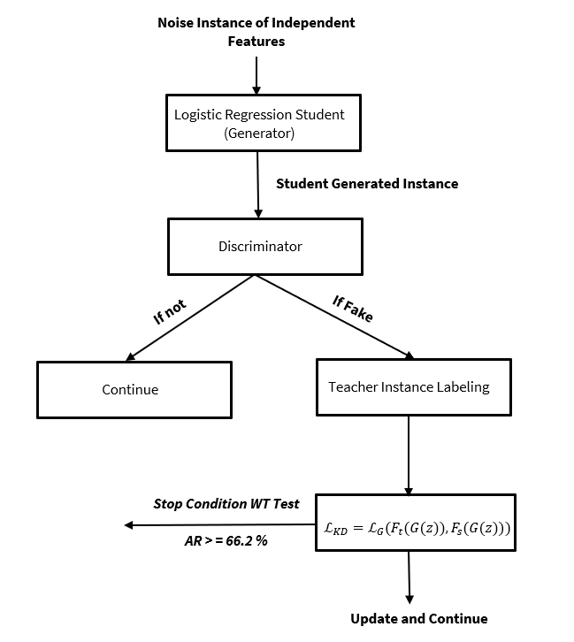
Adversarial Knowledge Distillation Framework (1/8)
Exploring Generative Knowledge Distillation Technique to Improve the Student AR TEST
This method will help the student to generalize well. In our case, student’s parameters are updated only when the generated instance is labeled as fake which help update parameters only when the model is mistaken and adjust its data distribution.
Figure 23. Adversarial Knowledge Distillation Training Framework Performed on PD Estimation Models. In this case, the generator is also the student which is a logistic regression. The teacher is the LightGBM used in the response-based framework.

Slide 24
Adversarial Knowledge Distillation Framework (2/8)
Discriminator Training Framework
The discriminator is trained to predict either a generated instance from the generator (the student in our case) is real or fake. In other words, it’s used to predict if a generated instance follows the real data distribution or not.
To train it, we generate fake instances including the dependent variable then, we label it as fake (1). In the other hand, we label real training instances as real (0). Then we concatenate and shuffle fake and real instances and finally train the discriminator model.
Fake data should be a random noise, containing examples that are both far away from real data distribution and near to real data distribution to challenge the discriminator model training.
Fake Data
Train
Discriminator
Real Data
Figure 24. Discriminator Training Flow
How to Construct Fake Data ?

Slide 25
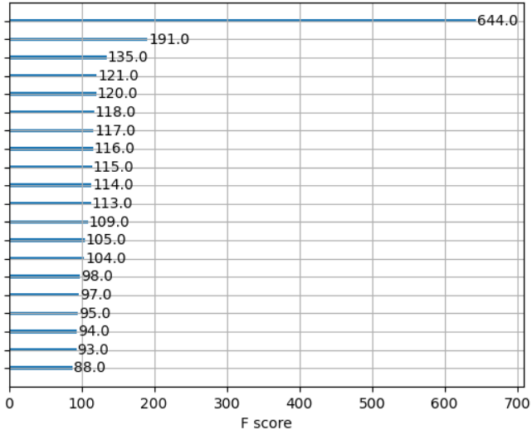
Adversarial Knowledge Distillation Framework (3/8)
Discriminator Training Framework - Fake Data Construction
1
2
3
4
5
6
7
8
9
10
11
12
13
14
15
16
17
18
Figure 25. Preliminary discriminator (LightGBM) training. The continuous variable has almost 6 times more importance comparing to other features.
The discriminator relies the most on the continuous feature to make its prediction. How to construct fake examples of this variable ?

Slide 26
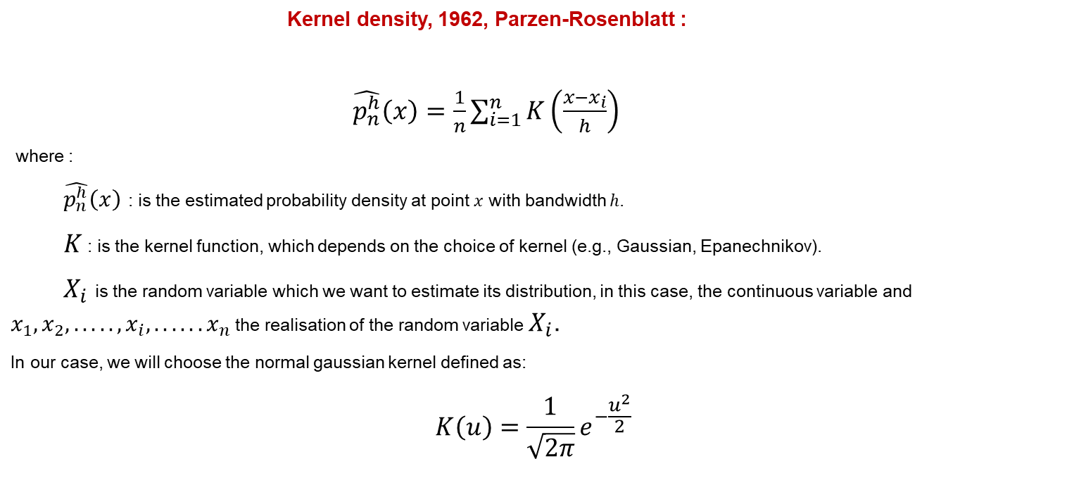
Adversarial Knowledge Distillation Framework (4/8)
Constructing Fake Instances of the Continuous Feature – Continuous Variable Distribution Approximation
Constructing an estimator of the probability distribution of the continuous variable with non-parametric estimation using kernel density
The idea is to sample the noise from a close estimation of the probability distribution of the continuous variable to avoid triviality and challenge the discriminator since the continuous variable is the most important feature of the model. The model relies mainly on it to make its prediction.
Kernel density, 1962, Parzen-Rosenblatt :
$\hat{p_{n}^{h}}\left(x\right)=\frac{1}{n}\sum_{i=1}^{n}{K\left(\frac{x−x_{i}}{h}\right)}$
where :
$\hat{p_{n}^{h}}\left(x\right)$ : is the estimated probability density at point $x$ with bandwidth ℎ.
$K$ : is the kernel function, which depends on the choice of kernel (e.g., Gaussian, Epanechnikov).
$X_{i}$ is the random variable which we want to estimate its distribution, in this case, the continuous variable and $x_{1}, x_{2}, ....., x_{i},...... x_{n}$ the realisation of the random variable $X_{i}$.
In our case, we will choose the normal gaussian kernel defined as:
$$K\left(u\right)=\frac{1}{\sqrt{2π}}e^{−\frac{u^{2}}{2}}$$

Slide 27
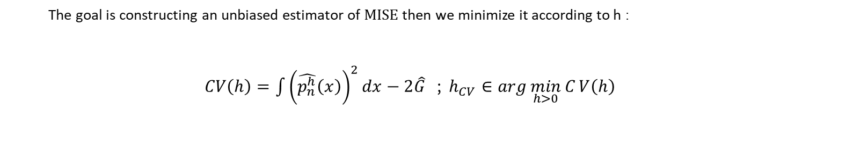
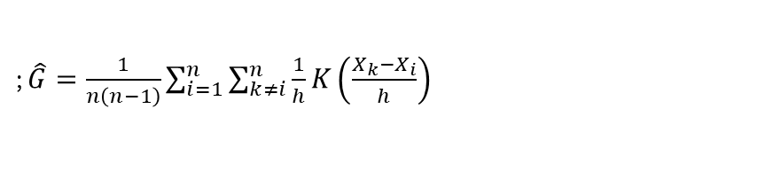
Adversarial Knowledge Distillation Framework (5/8)
Constructing Fake Instances of the Continuous Feature - Cross Validation to determine the optimal bandwidth h
Don’t depend on h
The goal is constructing an unbiased estimator of $\text{MISE}$then we minimize it according to h :
$CV\left(h\right)=\int{{\left(\hat{p_{n}^{h}}\left(x\right)\right)}^{2}}dx−2\hat{G}$ ; $h_{CV}∈\arg{\min_{h>0}{C}}V\left(h\right)$
; $\hat{G}=\frac{1}{n\left(n−1\right)}\sum_{i=1}^{n}{\sum_{k≠i}^{n}{\frac{1}{h}}K\left(\frac{X_{k}−X_{i}}{h}\right)}$
Computing is done from data
Computing is done using Trapezoidal Method and data

Slide 28
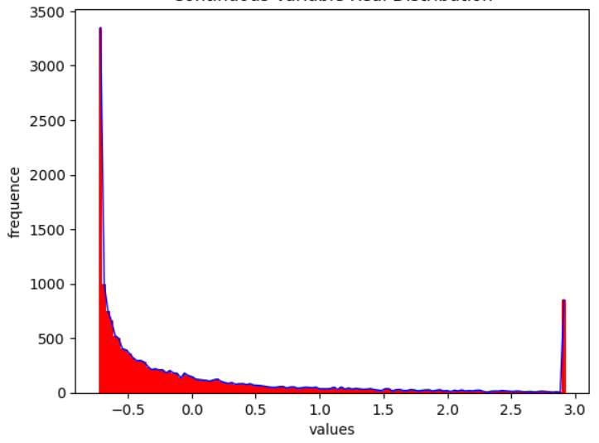
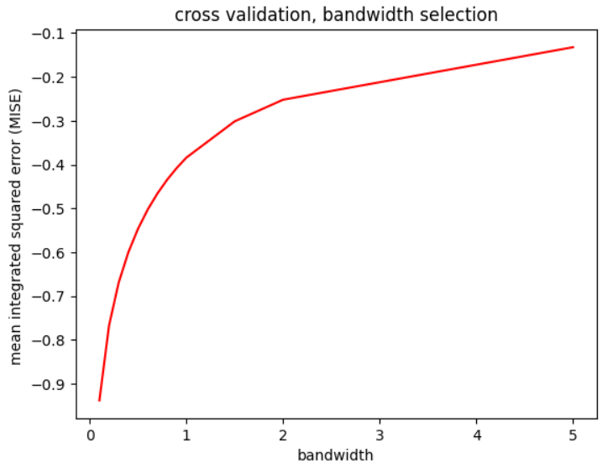
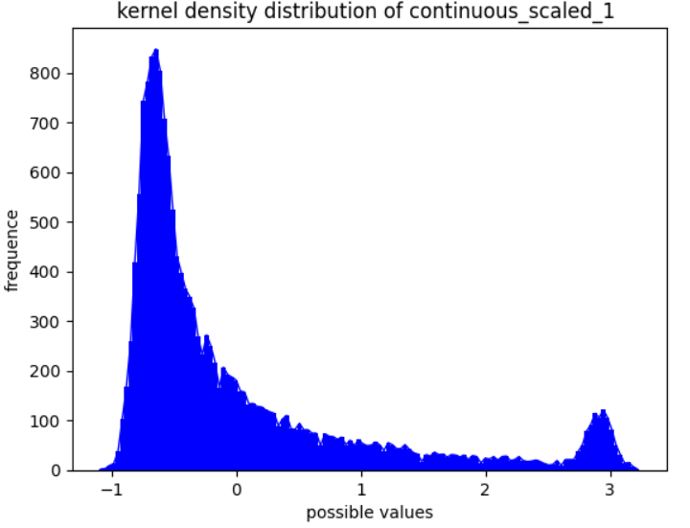
Adversarial Knowledge Distillation Framework (6/8)
Constructing Fake Instances of the Continuous Feature - Cross Validation to determine the optimal bandwidth h
Figure 27. Continuous variable distribution in the training data
Figure 26. Cross validation to select the best bandwidth h
Figure 28. Continuous variable’s distribution using Kernel Density
Approximation with h = 0.1

Slide 29
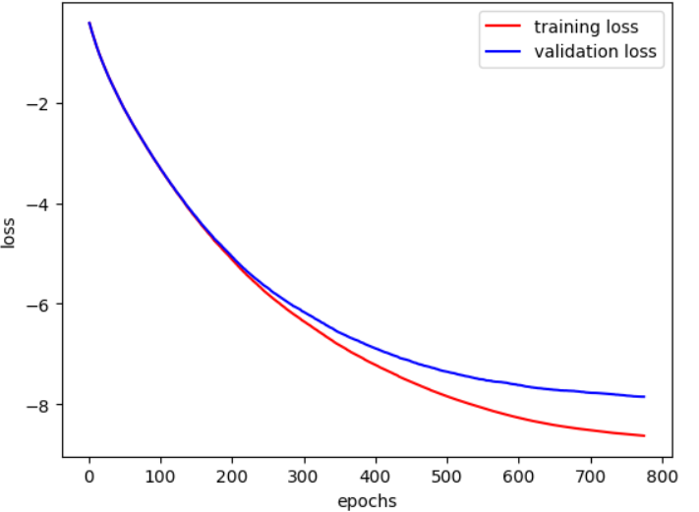
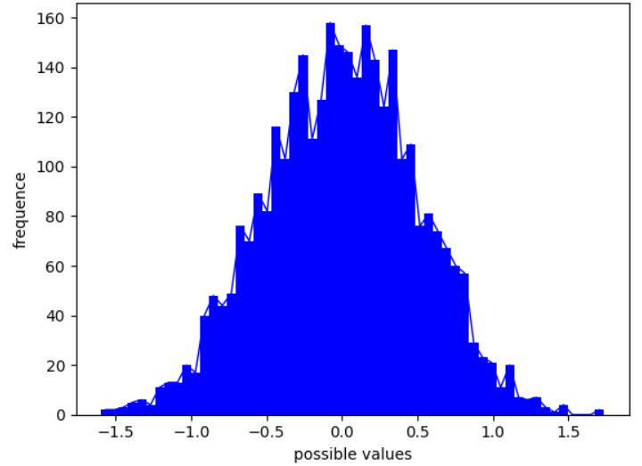
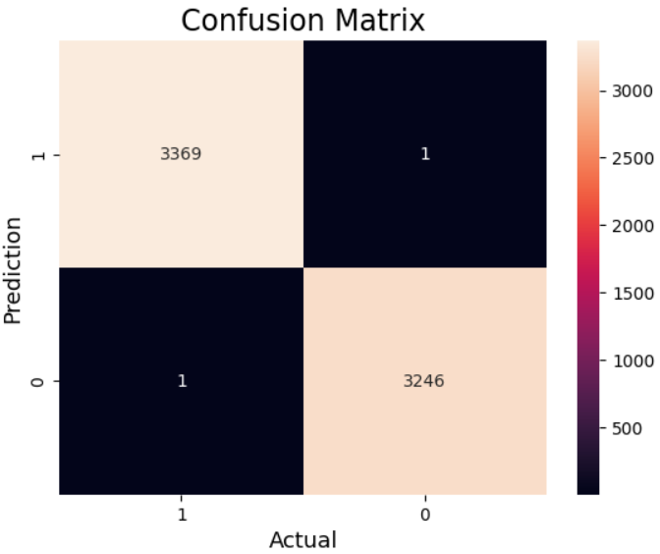
Adversarial Knowledge Distillation Framework (7/8)
Discriminator Training
Figure 30. Discriminator (LightGBM) Learning Curve
Figure 29. Noise Distribution of Continuous Variable During Test
Figure 31. Confusion Matrix of the LightGBM Discriminator

Slide 30
Adversarial Knowledge Distillation Framework (8/8)
Framework Results
Models | Role | Training AR (%) | WT Test AR (%) | OOT Test AR (%)
PD estimation models | Baseline | 65,40 | 66,20 | 66,40
LightGBM with regularization | Teacher | 70.87 | 67.41 | 71.44
PD estimation models distilled with response-based distillation with temperature | Student | 68.63 | 64.51 | 70.83
PD estimation models distilled with response-based with temperature + Adversarial Knowledge Distillation | Student | 68.99 | 66.20 | 72.14
Table 6. Students’ Performance using Adversarial Distillation Framework

Slide 31
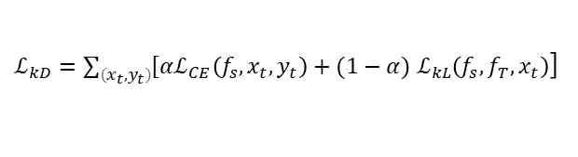
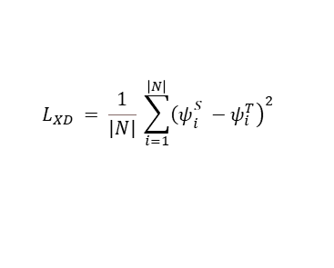
X-distillation Framework (1/8)
Exploring Interpretability Distillation (XD) Technique to Improve the Student AR TEST
.
Logits
Teacher
$ℒ_{kD}=\sum_{\left(x_{t},y_{t}\right)}{\left[αℒ_{CE}\left(f_{s},x_{t},y_{t}\right)\right.}+(1−α{) ℒ}_{kL}\left(f_{s}, f_{T},x_{t}\right)$]
Global SHAP Values*
Training Data
Reponse-Based Distillation Loss
X-Distillation Loss
Global SHAP Values
$$L_{XD} = \frac{1}{\left|N\right|} \sum_{i=1}^{\left|N\right|}{{\left.{\left(ψ\right.}_{i}^{S} −ψ_{i}^{T}\right)}^{2} }$$
Student
Logits
Figure 32. X-Distillation framework used to enhance student’s performance
* Corresponds to the absolute mean of local SHAP values across training instances

Slide 32
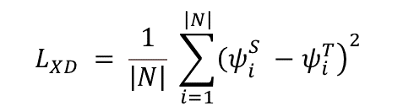
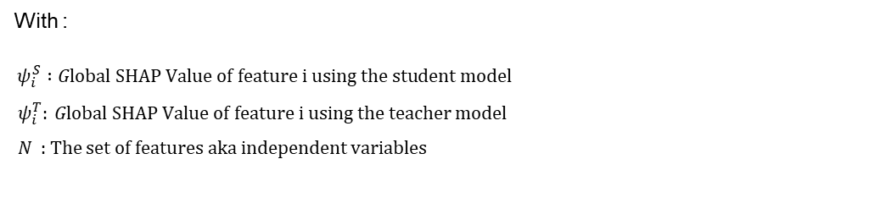
X-distillation Framework (2/8)
Student’s Global SHAP Values Expression as a Function of Logistic Regression Parameters – Approximation
In our case, the expression of X-distillation loss (or the optimization objective) can be expressed as the following:
$$L_{XD} = \frac{1}{\left|N\right|} \sum_{i=1}^{\left|N\right|}{{\left.{\left(ψ\right.}_{i}^{S} −ψ_{i}^{T}\right)}^{2} }$$
With :
$ψ_{i}^{S} :Global SHAP Value of feature i using the student model$
$ψ_{i}^{T}: Global SHAP Value of feature i using the teacher model$
$N$ : The set of features aka independent variables
To update our student’s (Logistic Regression) parameters ${ β}_{i}$. $ψ_{i}^{S}$ must be expressed as a function of ${ β}_{i}$ in order to perform gradient descent. However, calculating the theorical expression of ${ ψ}_{i}^{S}$ as a function of logistic regression parameters is not straightforward.
.

Slide 33
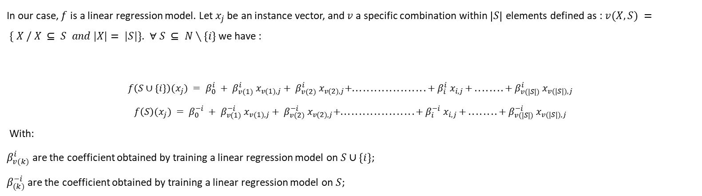
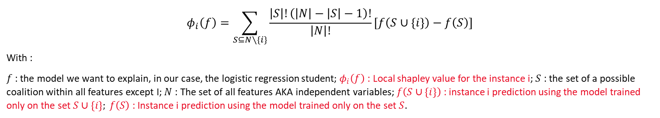
X-distillation Framework (3/8)
Student’s Global SHAP Values Expression as a Function of Logistic Regression Parameters – Approximation
The SHAP values kernel explainer can be expressed as:
$$φ_{i}\left(f\right)=\sum_{S⊆N∖\{i\}}{\frac{\left|S\right|!\left(\left|N\right|−\left|S\right|−1\right)!}{\left|N\right|!}}\left[f\left(S∪\{i\}\right)−f\left(S\right)\right]$$
With :
$f$: the model we want to explain, in our case, the logistic regression student; $φ_{i}\left(f\right)$ : Local shapley value for the instance i; $S$ : the set of a possible coalition within all features except I; $N$ : The set of all features AKA independent variables; $f\left(S∪\{i\}\right)$ : instance i prediction using the model trained only on the set $S∪\{i\}; f\left(S\right)$: Instance i prediction using the model trained only on the set $S$.
In our case, $f$ is a linear regression model. Let $x_{j}$ be an instance vector, and $v$ a specific combination within $\left|S\right|$ elements defined as : $v(X, S) = \{ X / X ⊆ S and |X|= |S|\}$. $∀ S ⊆ N∖\{i\}$ we have :
$$f\left(S∪\{i\}\right)(x_{j}) = β_{0}^{i} + β_{v(1)}^{i} x_{v(1),j}+ β_{v(2)}^{i} x_{v(2),j}+....................+ β_{i}^{i} x_{i,j }+ ........ + β_{v(|S|)}^{i} x_{v(|S|),j }$$
$$f\left(S\right)(x_{j}) = β_{0}^{−i} + β_{v(1)}^{−i} x_{v(1),j}+ β_{v(2)}^{−i} x_{v(2),j}+....................+ β_{i}^{−i} x_{i,j }+ ........ + β_{v(|S|)}^{−i} x_{v(|S|),j }$$
With:
$β_{v(k)}^{i}$ are the coefficient obtained by training a linear regression model on $S∪\{i\}$;
$β_{(k)}^{−i}$ are the coefficient obtained by training a linear regression model on $S$;
.

Slide 34
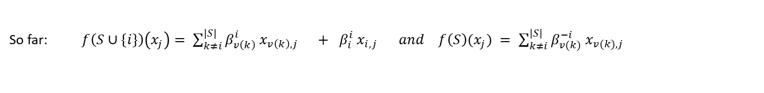

X-distillation Framework (4/8)
Student’s Global SHAP Values Expression as a Function of Logistic Regression Parameters – Approximation
So far: $f\left(S∪\{i\}\right)\left(x_{j}\right)= \sum_{k≠i}^{\left|S\right|}{β_{v\left(k\right)}^{i} x_{v\left(k\right),j} + β_{i}^{i} x_{i,j } } and f\left(S\right)(x_{j}) = \sum_{k≠i}^{|S|}{β_{v(k)}^{−i} x_{v(k),j} }$
So, the Shapley value of a feature i is simplified as :
$$φ_{i}\left(f\right)=\sum_{S⊆N∖\{i\}}{\frac{\left|S\right|!\left(\left|N\right|−\left|S\right|−1\right)!}{\left|N\right|!}}\left[\sum_{k≠i}^{|S|}{{( β}_{v(k)}^{i}−β_{v(k)}^{−i}) x_{v(k),j } + β_{i}^{i} x_{i,j } }\right]$$
Let’s denote:
$$C_{1}^{S} = \frac{\left|S\right|!\left(\left|N\right|−\left|S\right|−1\right)!}{\left|N\right|!} ; C_{2,i}^{S}= \sum_{k≠i}^{|S|}{{( β}_{v(k)}^{i}− β_{v(k)}^{−i}) x_{v(k),j } }$$
In this case, we have:
$$φ_{i}\left(f\right)=\sum_{S⊆N∖\{i\}}{C_{1}^{S}}\left[C_{2,i}^{S} + β_{i}^{i} x_{i,j }\right]$$
.
Approximation : Let’s assume that $C_{2,i}^{S} = 0$, which means that $β_{v(k)}^{i}= β_{v(k)}^{−i}$. Training $f$ for each coalition $S$ is cumbersome. Instead, we attribute the value zero to features excluded $S$.

Slide 35
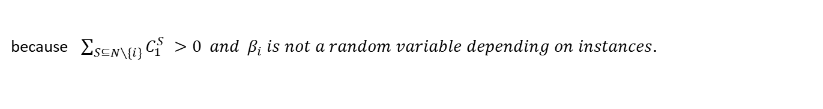
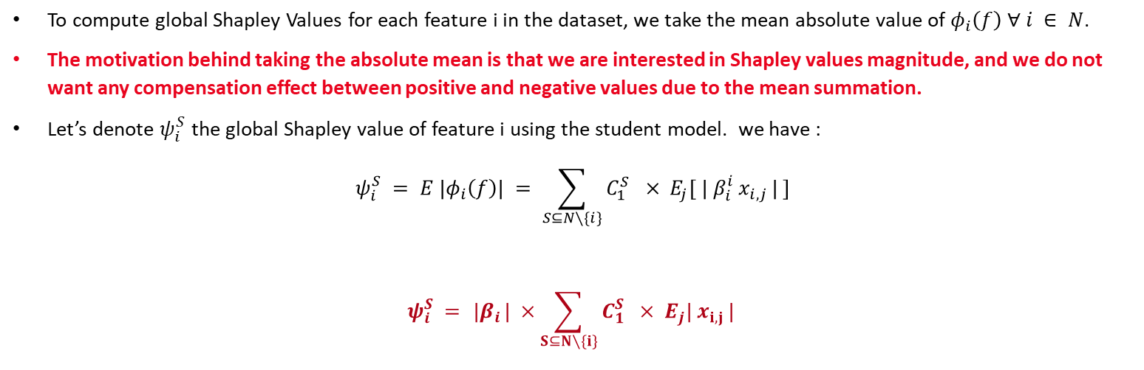
X-distillation Framework (5/8)
Student’s Global SHAP Values Expression as a Function of Logistic Regression Parameters – Approximation
To compute global Shapley Values for each feature i in the dataset, we take the mean absolute value of $φ_{i}\left(f\right)$ $∀ i ∈ N$.
The motivation behind taking the absolute mean is that we are interested in Shapley values magnitude, and we do not want any compensation effect between positive and negative values due to the mean summation.
Let’s denote $ψ_{i}^{S}$ the global Shapley value of feature i using the student model. we have :
$$ψ_{i}^{S} = E |φ_{i}\left(f\right)| = \sum_{S⊆N∖\{i\}}{C_{1}^{S}} × E_{j}[{ | β}_{i}^{i} x_{i,j }| ]$$
$$ψ_{i}^{S} = { |β}_{i}| ×\sum_{S⊆N∖\{i\}}{C_{1}^{S}} × E_{j}| x_{i,j }|$$
because $\sum_{S⊆N∖\{i\}}{C_{1}^{S}} >0 and { β}_{i} is not a random variable depending on instances.$
.
Now that we have the expression of the Shapley values of our linear model $f$ expressed using the coefficients ${ β}_{i}$ . we can calculate the gradient of XDistillation loss between student’s Shapley values and teacher Shapley values

Slide 36
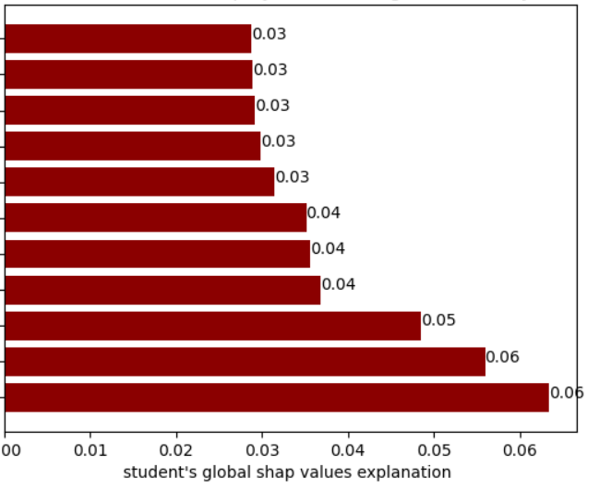
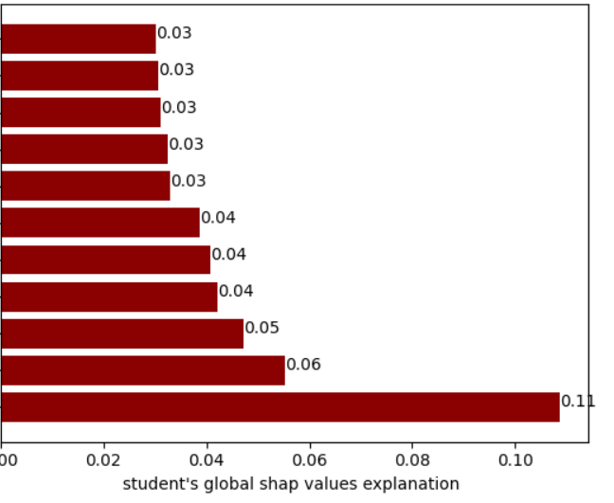
X-distillation Framework (6/8)
Student’s Global SHAP Values Expression as a Function of Logistic Regression Parameters – Approximation
1
1
2
2
3
3
4
4
5
5
6
6
7
7
8
8
9
9
10
10
11
11
Figure 33. Student’s global Shapley values using SHAP library in Python
Figure 34. Student’s global Shapley values using kernel explainer approximation
.

Slide 37
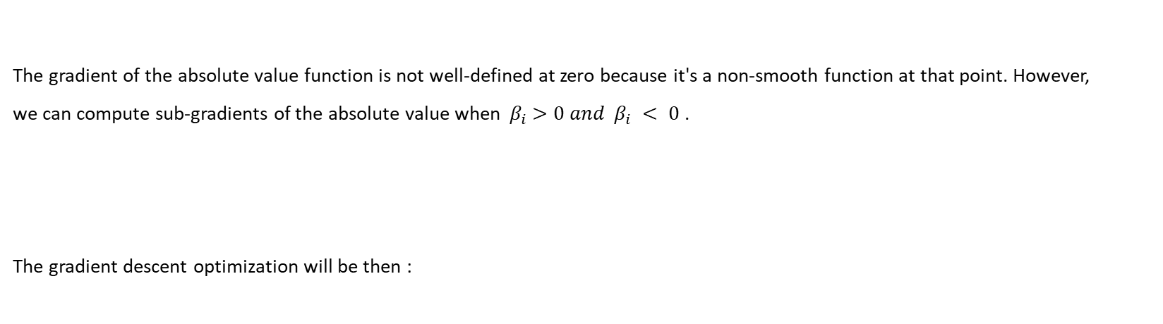
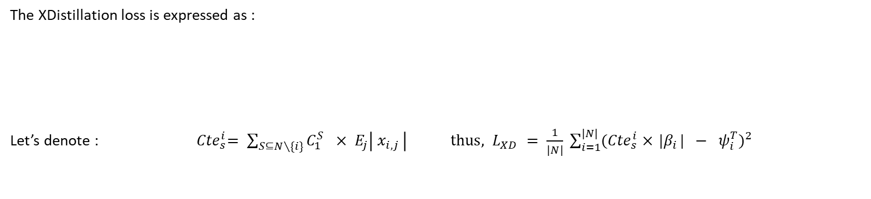
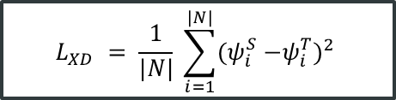


Xdistillation Framework (7/8)
Student’s Global SHAP Values Expression as a Function of Logistic Regression Parameters – Approximation
The XDistillation loss is expressed as :
Let’s denote : ${ Cte}_{s}^{i}= \sum_{S⊆N∖\{i\}}{C_{1}^{S}} × E_{j}\left| x_{i,j }\right| thus, L_{XD} = \frac{1}{|N|} \sum_{i=1}^{|N|}{{{(Cte}_{s}^{i} ×{ |β}_{i}| − ψ_{i}^{T})}^{2} }$
$$L_{XD} = \frac{1}{|N|} \sum_{i=1}^{|N|}{{{(ψ}_{i}^{S} −ψ_{i}^{T})}^{2} }$$
The gradient of the absolute value function is not well-defined at zero because it's a non-smooth function at that point. However,
we can compute sub-gradients of the absolute value when ${ β}_{i} >0 and { β}_{i} < 0$ .
The gradient descent optimization will be then :
$$\frac{∂L_{XD}}{∂{ β}_{i}} =\frac{2}{\left|N\right|} ×{(−1)}^{𝟙_{{ (β}_{i}<0)}} ×{Cte}_{s}^{i}× ({ |β}_{i}| × {Cte}_{s}^{i} − ψ_{i}^{T})$$
.
$$β_{i, m+1} = β_{i, m }− α× \frac{∂L_{XD}}{∂{ β}_{i}}$$

Slide 38

X-distillation Framework (8/8)
X-Distillation Framework Results
Models | Role | Training AR (%) | WT Test AR (%) | OOT Test AR (%)
PD estimation models | Baseline | 65,40 | 66,20 | 66,40
LightGBM with regularization | Teacher | 70.87 | 67.41 | 71.44
PD estimation models distilled with response-based distillation only without temperature | Student | 68.03 | 63.94 | 70.13
PD estimation models trained with response-based distillation only with temperature | Student | 68.63 | 64.51 | 70.83
PD estimation models distilled with response-based distillation with temperature + adversarial knowledge distillation | Student | 68.99 | 66.20 | 72.14
PD estimation models trained with Response-Based Distillation with temperature + X-Distillation | Student | 70.09 | 66.01 | 72.78
Figure 35 . Cross validation for best temperature T selection in X-Distillation. Here T = 4.12
Table 7. X-Distillation framework performance comparing with other frameworks
.
Takeaways :
+ 6.38 gain in performance on the OOT Test AR.
Same performance on WT Test AR due to dataset variability.

Slide 39
THANK YOU FOR YOUR ATTENTION

Slide 40
REFERENCES
Craven and al., 1995: Extracting Tree-Structured Representations of Trained Networks
Caruana and al.,2006: model compression
Hinton and al.,2015: Distilling the Knowledge in a Neural Network
Han and al., 2015: Learning both Weights and Connections for Efficient
Hoffman and al., 2015: Cross Modal Distillation for Supervision Transfer
Zagoruyko and al., 2017: Attention Transfer
Huang and al., 2017: Knowledge Distill via Neuron Selectivity Transfer
Caruana and al., 2017: Interpretable & Explorable Approximations of Black Box Models
Yim and al, 2017: A Gift from Knowledge Distillation: Fast Optimization, Network Minimization and Transfer Learning
Burda, Edwards and al., 2018: Exploration by Random Network Distillation
Caruana and al., 2018: Distill-and-Compare: Auditing Black-Box Models Using Transparent Model Distillation
Liu and al., 2018: Improving the Interpretability of Deep Neural Networks with Knowledge Distillation
Asadulaev and al., 2019: Interpretable Few-Shot Learning via Linear Distillation
Bastani and al., 2019: Interpreting Blackbox Models via Model Extraction
Zhang and al, 2021: Adversarial co-distillation learning for image recognition

Slide 41

APPENDIX- DISTILLATION TESTS ON LENDING CLUB dataset (1/7)
Teacher Training – Feed-Forward Neural Networks
Metric | Train | Test
ROC AUC | 0.909 | 0.906
F1-Score | 0.6281 | 0.6249
Table 8. Teacher Performance
Figure 36. Neural Network Teacher’s Learning Curve

Slide 42

APPENDIX- DISTILLATION TESTS ON LENDING CLUB dataset (2/7)
Teacher Training – XGBOOST
Metric | Train | Test
ROC AUC | 0.909 | 0.906
F1-Score | 0.651 | 0.627
Table 9. XGBOOST Teacher Performance
Figure 37. XGBOOST Teacher’s Learning Curve

Slide 43

APPENDIX- DISTILLATION TESTS ON LENDING CLUB dataset (3/7)
Student Training – Feed-Forward Neural Network
Figure 38. The generic feature-based knowledge distillation
Figure 39. Multi-teacher Distillation Framework’s Illustration
Models | ROC AUC TRAIN | ROC AUC TEST
FFNN Teacher | 90.96% | 90.65%
XGBOOST Teacher | 92,86% | 90.73%
Student with Hinton-Based Distillation | 71.45% | 71.48%
Student with Multi-Teacher Distillation | 88.95% | 88.97%
Student with Feature-Based Distillation | 71.44% | 71.47%
Selected Teacher
Compression Ratio = 51.41
Model | #parameters
Teacher | 58,357
Student | 1,135
Table 11. Student’s performance
Table 10. Student’s Performance using different Distillation Frameworks

Slide 44


APPENDIX (4/7)
Cross Validation to determine the optimal bandwidth h
Don’t depend on h
The goal is construct an unbiased estimator of $\text{MISE}$then we minimize it according to h. Let’s denote :
$$τ(h)=E\left[\int{{\left(\hat{p_{n}^{h}}\left(x\right)\right)}^{2}}dx\right]−2× E\left[\int{\hat{p_{n}^{h}}\left(x\right)p\left(x\right)}dx\right]$$
$\int{{\left(\hat{p_{n}^{h}}\left(x\right)\right)}^{2}}dx$ is an unbiased estimator of $E\left[\int{{\left(\hat{p_{n}^{h}}\left(x\right)\right)}^{2}}dx\right]$
Let’s construct an unbiased estimator for the second term:
$$E_{p}\left[\int{\hat{p_{n}^{h}}\left(x\right)p\left(x\right)}dx\right]=E_{p}\left[\int{\left(\frac{1}{n}\sum_{i=1}^{n}{\frac{1}{h}}K\left(\frac{X_{i}−x}{h}\right)\right)p\left(x\right)} dx\right]$$

Slide 45


APPENDIX (5/7)
Cross Validation to determine the optimal bandwidth h
$$E_{p}\left[\int{\hat{p_{n}^{h}}\left(x\right)p\left(x\right)}dx\right]=\int{E_{p}\left[\frac{1}{h}K\left(\frac{X_{i}−x}{h}\right)\right]p\left(x\right)} dx=\int{\int{\frac{1}{h}}K\left(\frac{y−x}{h}\right)p\left(y\right)p\left(x\right)} dy dx$$
Using the leave one-out estimator leave-one out of p, let’s denote : $\hat{G}=\frac{1}{n\left(n−1\right)}\sum_{i=1}^{n}{\sum_{k≠i}^{n}{\frac{1}{h}}K\left(\frac{X_{k}−X_{i}}{h}\right)}$
Which give this passing the expectancy $E_{p}\left(\hat{G}\right)=\frac{1}{n\left(n−1\right)}\sum_{k≠i}{\frac{1}{h}}E_{p}\left[K\left(\frac{X_{k}−X_{i}}{h}\right)\right]$
The joint distribution of ${(X}_{k}, X_{i})$ is $p\left(y\right)p\left(x\right)$ (Independent Variables), Thus,
$E_{p}\left(\hat{G}\right)=\frac{1}{h}\int{\int{K\left(\frac{y−x}{h}\right)p\left(y\right)p\left(x\right)}} dy dx$
So $\hat{G}$ is an unbiased estimator of $E\left[\int{\hat{p_{n}^{h}}\left(x\right)p\left(x\right)}dx\right]$. Thus, the cross-validation objective is defined as:
$CV\left(h\right)=\int{{\left(\hat{p_{n}^{h}}\left(x\right)\right)}^{2}}dx−2\hat{G}$ ; $h_{CV}∈\arg{\min_{h>0}{C}}V\left(h\right)$
Trapezoidal method
From data

Slide 46




Appendix (6/7)
EXAMPLE OF RELATION-BASED DISTILLATION FRAMEWORK
A novel example is distilling the flow of solution process (FSP) matrix Yim and al, 2017. The FSP matrix is generated by crossing feature representation of two selected layers across data using inner product, gram representation, or other capturing-information product depending on the problem.
Advantage:
Fast Optimization and outperforms Hinton knowledge distillation
Figure 40. Complete architecture of FSP KD. There are two stages. In stage 1, the student network is trained to minimize the distance between the FSP matrices of the student and teacher networks. Then, the pretrained weights of the student DNN are used for the initial weight in stage 2. Stage 2 represents the normal training procedure
Example of FSP construction as in Yim and al, 2017: 1) Take the feature map matrix of layer i and layer j. 2) Construct the Gramian matrix; 3) sum up over all terms; 4) repeat the process across selected layers. NB: 1) the number of selected layers must be the same in the teacher and the student; 2) this is only a construction example.
24

Slide 47

appendix (7/7)
EXAMPLE OF SELF-DISTILLATION FRAMEWORK
Self-distillation is a variant of online distillation where the teacher and student share the same architecture. It is often used to enhance neural networks performance comparing to the traditional training mode. As a framework’s example, adversarial co-distillation (ACN) by Zhang and al, 2021 is a novel technique to enhance the performance of a CNN in the image recognition task by generating divergent examples where models do not totally agree. The goal is to have them make the same prediction accurately based on a majority vote mindset.
Model | Original trained | ACN
Resnet-20 | 68.22% | 70.67%
VGG11 | 67.38% | 70.11%
AlexNet | 39.45% | 46.27%
Table 12. Distillation learning can be used to enhance complex models’ performance without compression
Figure. 41. The framework illustration of ACNs. ACNs consist of an Adversarial Phase and a Co-distillation Phase. The Adversarial Phase generates the divergent examples, and the Co-distillation Phase learn the divergent examples. The Adversarial Phase is designed according to the GANs framework.
25

Slide 48
B. Relevant frameworks (3/3)
Multi-teacher Distillation
Problem | Usage example | Pros
1) Bias coming from one the teacher 2) Lack of knowledge using one teacher | 2 teachers, one transfers response-based knowledge and the other transfers feature-based knowledge (Chen et al. 2019b). | Provide richer knowledge to the student Straightforward
Figure 14. The generic multi-teacher knowledge distillation framework
Table 6. Multi-teacher Distillation Framework’s detailed explanation.

